Slide 1

Market Churn
Team Member:
Rozhan Makhdoomi
Wei Guo
Shubhada Gopale
Sumithra Hariguruprasad

Slide 2
1
Define the Issue
2
Data Preparation
3
Modeling
Model 1: Naïve Bayes
Model 2: Decision Tree
Model 3: KNN
Model Evaluation and Comparison
4
Conclusion

Slide 3

Background
Roz
the telecom company would like to know in advance which customers would churn in near future
help this company in characterizing customer churn

Slide 4
1
Define the Issue
2
Data Preparation
3
Modeling
Model 1: Naïve Bayes
Model 2: Decision Tree
Model 3: KNN
Model Evaluation and Comparison
4
Conclusion

Slide 5
Available Metrics
Roz
Xx metrics,
Churn is the predicted value
No null values
Category | Metric | Data Type
 | State
 | Account Length
 | Area Code
 | Phone Number
 | Inter Plan
 | VoiceMail Plan
 | No of Vmail Mesgs
 | No of Calls Customer Service
 | Churn
 | Total Day Min
 | Total Day Calls
 | Total Day Charge
 | Total Evening Min
 | Total Evening Calls
 | Total Evening Charge
 | Total Night Min
 | Total Night Calls
 | Total Night Charge
 | Total Int Min
 | Total Int Calls
 | Total Int Charge

Slide 6
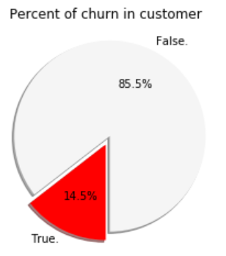
Facts
Roz
14.5% of customers have churned
The company has its most clients in West Virginia State. There is no evident relationship between different states and the customer's leave.
Half of the clients remain in the company for more than 101 months
The average total revenue generated per customer is $67.49
Each customer had an average 305 calls in the course of using the service of this company
Half of the clients has called the customer service at least one time
most of the customers that left paid more than $60 in total charge. In range of $60 to $85 in total charges, population of loyal customer is around half of the population of customers who left. So we can assume that the reason why the customers have left is the quality or the high cost of the services.

Slide 7
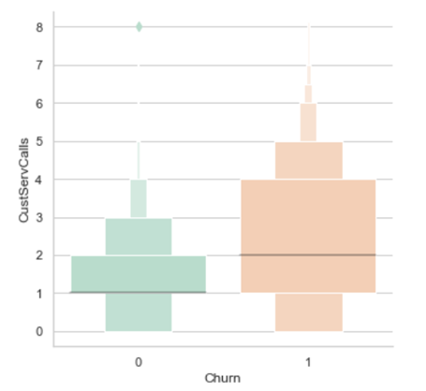
Higher number of customer calls increase the possibility of customer churn

Slide 8
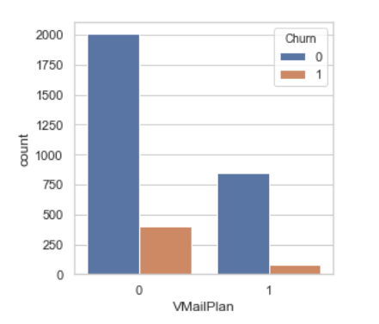
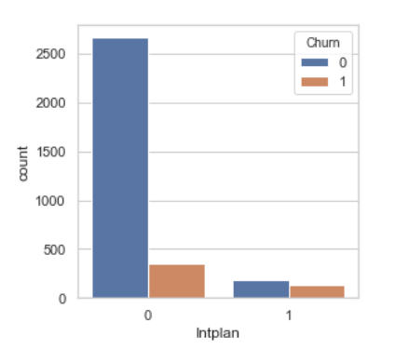
International Plan is not attractive to customers Voicemail Plan seems to be more attractive

Slide 9
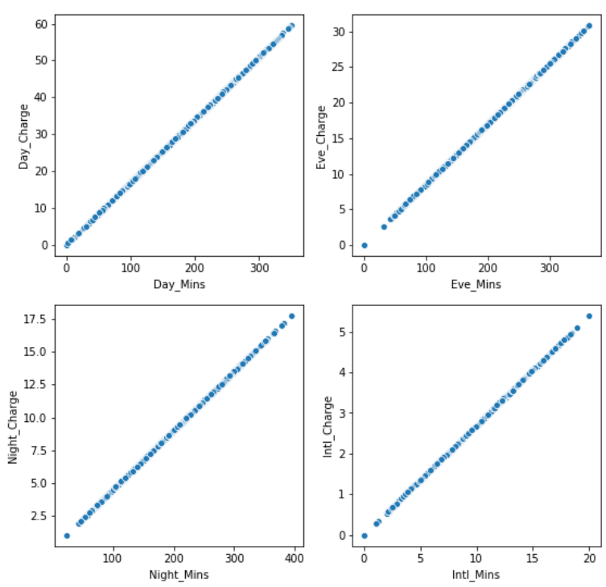
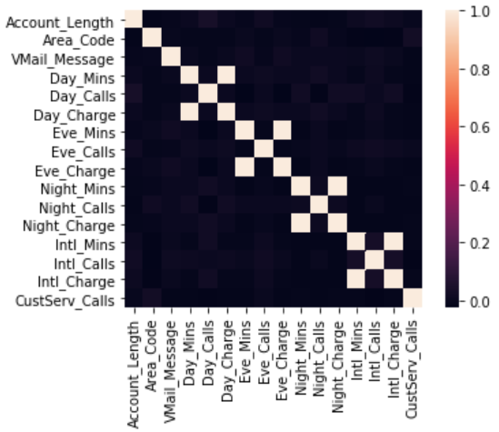
Correlation
Grace
Correlation between metrics
High correlation between:
Day_charge & Day_Mins
Eve_charge & Eve_Mins
Night_charge & Night_Mins
Intl_charge & Intl_Mins
Drop 'Day_Charge’, 'Eve_Charge’, 'Night_Charge', 'Intl_Charge'

Slide 10
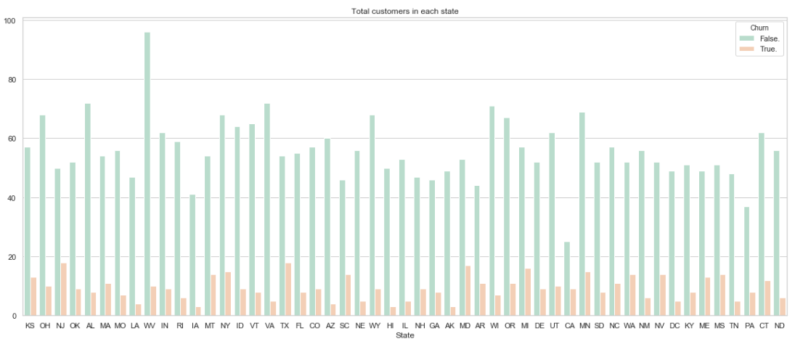
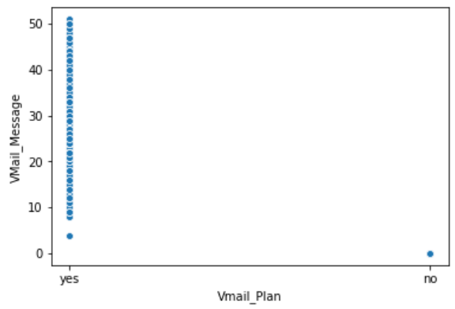
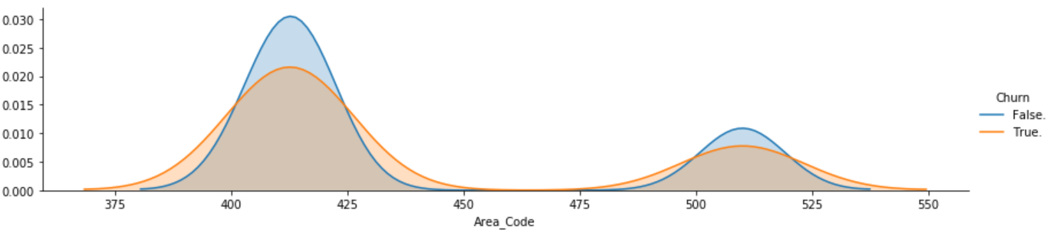
Variable Dropped
Grace
Variable | Distribution | Note
State |  | Drop “State”
Vmail_Plan & Vmail_Message |  | High correlation between Vmail_Plan & Vmail_Message Drop “Vmail_Plan”
Area Code |  | Drop “Area Code”

Slide 11
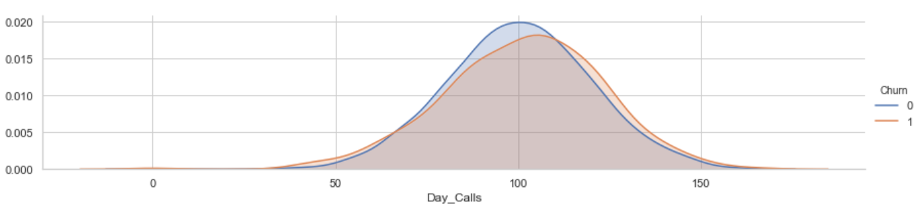
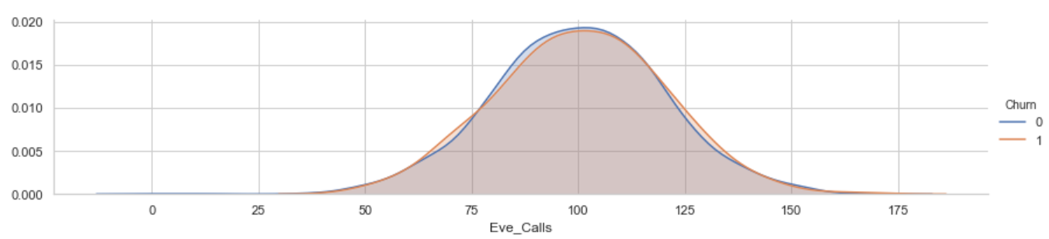
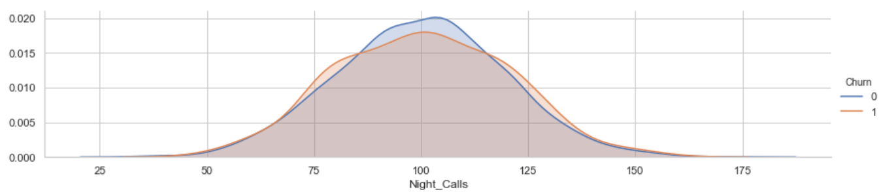
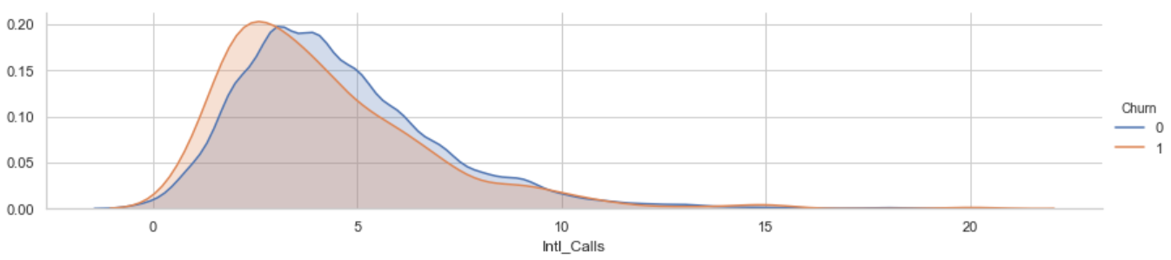
Variable Dropped (Cont.)
Grace
Variable | Distribution | Note
Day_Calls, Eve_Calls, Night_Calls, Intl_Calls |  | No big differences between Churn and not Churn Drop “Day_Calls”, “Eve_Calls”, “Night_Calls”, “Intl_Calls”
Other areas dropped: Phone

Slide 12
Additional Metrics
Shub

Slide 13
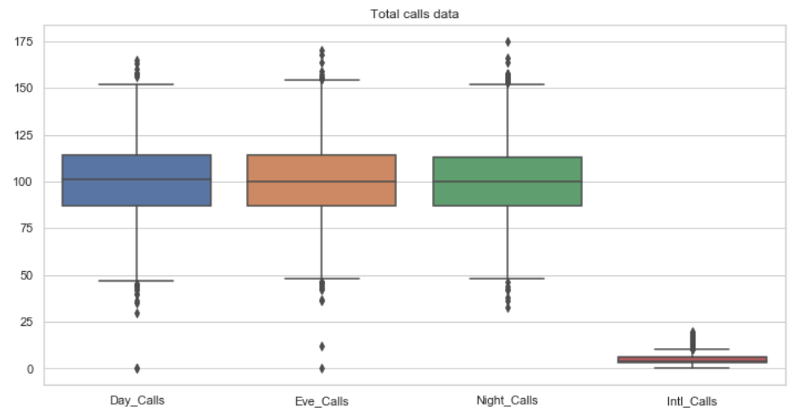
Outlier
Shub

Slide 14
Final Metrics in the Model
Shub

Slide 15
1
Define the Issue
2
Data Preparation
3
Modeling
Model 1: Naïve Bayes
Model 2: Decision Tree
Model 3: KNN
Model Evaluation and Comparison
4
Conclusion

Slide 16
Measuring Metric Chosen
Sumithra
 | Description | Pros / Cons
Accuracy

Slide 17
1
Define the Issue
2
Data Preparation
3
Modeling
Model 1: Naïve Bayes
Model 2: Decision Tree
Model 3: KNN
Model Evaluation and Comparison
4
Conclusion

Slide 18
Model 1: Naïve Bayes
Sumithra
Method :xxx
Pros and cons
Results: xxx
Model Comparison
(if you run multiple models, the comparison)

Slide 19
Model 2: Random Forrest
Shub
Method :xxx
Results: xxx
Model Comparison

Slide 20
Model 3: KNN
Grace
k-NN is non-parametric lazy learning algorithm
Pro: Does not assume any probability distributions on the input data
Con: If one type of category occurs much more than another, classifying an input will be more biased towards that one category
Parameter | Evaluation Accuracy | Test Accuracy
N = 3 | 0.867 | 0.859
N = 5 | 0.885 | 0.874
N = 7 | 0.887 | 0.874

Slide 21
1
Define the Issue
2
Data Preparation
3
Modeling
Model 1: Naïve Bayes
Model 2: Decision Tree
Model 3: KNN
Model Evaluation and Comparison
4
Conclusion

Slide 22
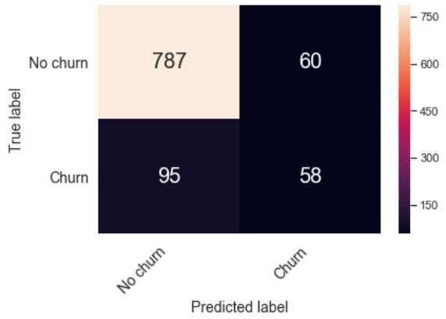
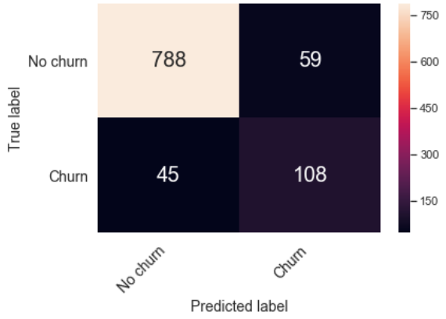
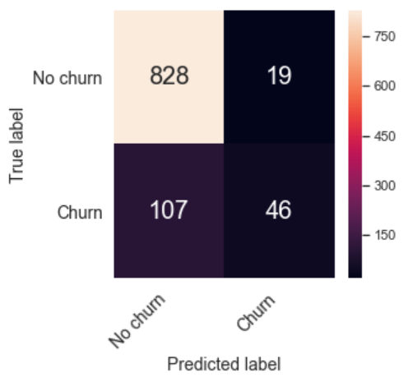
Model Comparison
Grace
Model | Evaluation Accuracy | Test Accuracy | Diff (Evaluation – Test) | Confusion Matrix Results
Model 1: Naive Bayes (Gaussian ) | 0.850 | 0.845 | 0.005
Model 2: Decision Tree | 0.889 | 0.896 | -0.007
Model 3: KNN (N = 5) | 0.885 | 0.874 | 0.011

Slide 23
1
Define the Issue
2
Data Preparation
3
Modeling
Model 1: Naïve Bayes
Model 2: Decision Tree
Model 3: KNN
Model Evaluation and Comparison
4
Conclusion

Slide 24
Feature Importance
Sumithra

Slide 25
Conclusion
Roz

Slide 26
Thank you!

Slide 27
Appendix

Slide 28
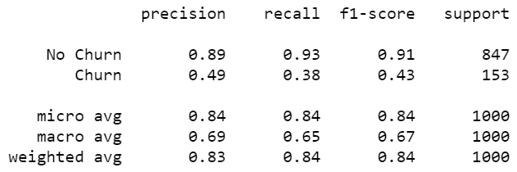
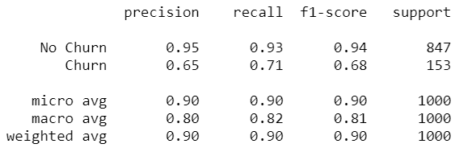
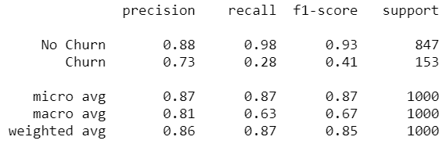
Other Results
 | Other Scoring Metrics | Confusion Matrix Results
Model 1: Gaussian Naive Bayes
Model 2: Decision Tree
Model 3: KNN

Slide 29
SlidesCarnival icons are editable shapes.
This means that you can:
Resize them without losing quality.
Change fill color and opacity.
Change line color, width and style.
Isn’t that nice? :)
Examples:

Slide 30
😉
Now you can use any emoji as an icon!
And of course it resizes without losing quality and you can change the color.
How? Follow Google instructions https://twitter.com/googledocs/status/730087240156643328
✋👆👉👍👤👦👧👨👩👪💃🏃💑❤😂😉😋😒😭👶😸🐟🍒🍔💣📌📖🔨🎃🎈🎨🏈🏰🌏🔌🔑 and many more...

